Slide 1
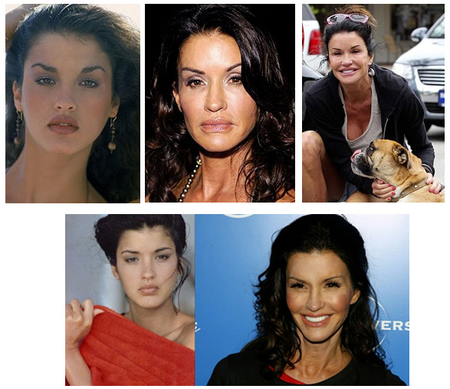


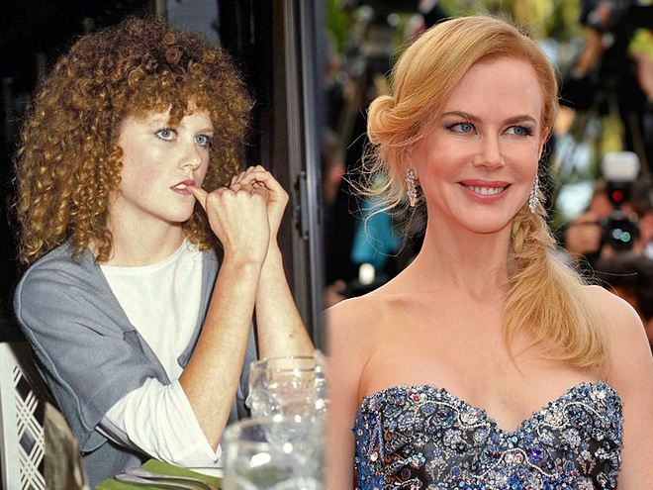
Development of plastic surgery

Slide 2

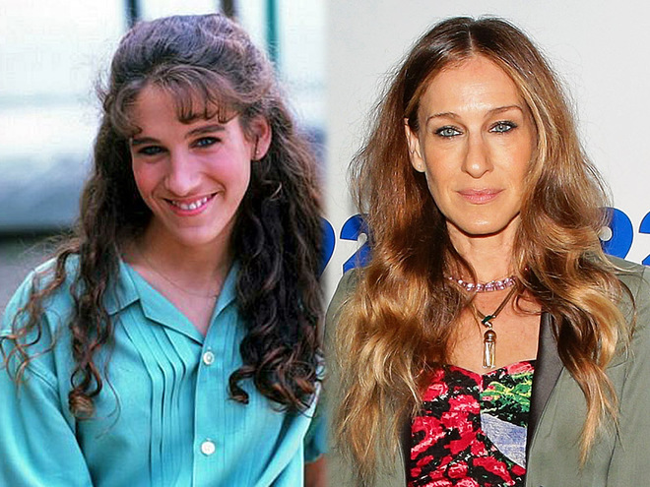
Every year medicine strides farther, there are not only new drugs and medicines, but also ways to improve our own appearance. Since ancient times, appearance was important for building relationships.
In addition, people with beautiful appearance always were very successful because they were more sociable and had no complexes about their species. Those who are less fortunate, sought to excel in different areas, but their cherished dream has always been beauty.
Over time, this problem has found its solution and the method was to approach the ideal and hide weaknesses. The first way to change the human appearance is considered to be plastic surgery, which enjoys relevance and today.
To understand how much successful modern technology, refer to history and consider the history of plastic surgery.

Slide 3

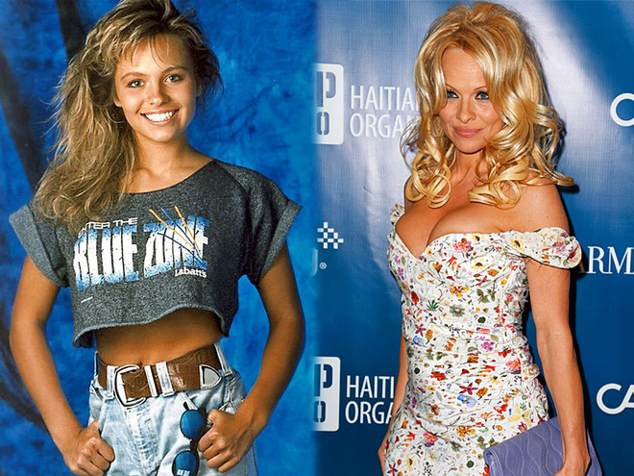
What is plastic surgery
Today it is assumed that plastic surgery - is the only way to improve the appearance, however, is not quite true. Originally invented plastic surgery to reconstruct parts of the body, skin and organs that have been damaged as a result of any injuries or illnesses, or have changed in the course of development, becoming in birth defects.
In fact, plastic surgery is divided into two major subtypes, aesthetic and reconstructive surgery. As you might have guessed, that aesthetic surgery is responsible for the appearance, but it is only one-third of all plastic surgery, the other part accounted for reconstructive surgery.
The essence of plastic surgery is to remove unwanted tumors, surgery to restore facial expressions, operations on bones, allowing correct shape and curves of the body, as well as correcting external defects, such as a large nose, protruding ears, or remove wrinkles and saggy skin.
Despite the differences in the two types of plastic surgery they use the same or similar methods of operation. All new development can be used both in aesthetic and in reconstructive surgery.

Slide 4
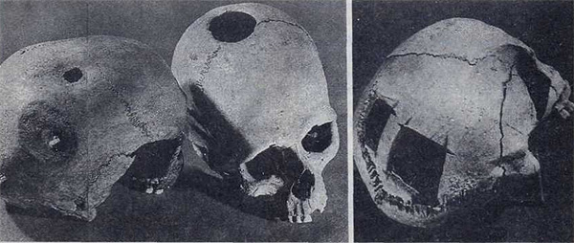
When did plastic surgery appear
Probably many of us believe that plastic surgery was only after the creation of special equipment and due to technological and scientific progress, allowing you to conduct safely even the most complex operations. But it is not.
With archaeological findings and historical facts, it is possible to say that plastic surgery originated long before the modern equipment. The first evidence of the use of plastic surgery has been found for several hundred years BC.
The first operation, which belong to the category of plastic surgery, craniotomy is performed by doing holes in the skull. Information about such surgery appeared 600 years BC.
Later signs of plastic surgery was found in ancient Egypt. There was also performed one of the first operations to restore the nose by transplanting skin from other parts of the body.

Slide 5
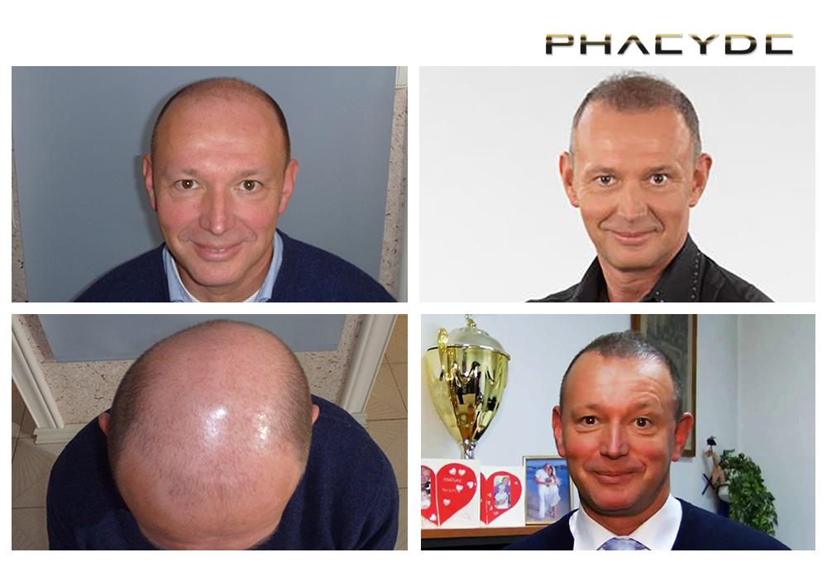
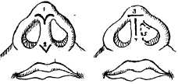
The development of plastic surgery
Despite the fact that the first birth of plastic surgery observed in ancient times, its main development it was in the 19th century. At that time widely practiced operations to restore the nose and skin grafts on his face.
Besides it was widely used plastic of lips. To do this, they used the skin of the arm or hand that quickly regenerate.
At the same time the first book on plastic surgery was published, which mentioned the possibility of plastic surgery and presented a description of it in detail. By the late 19th century there was already a large number of various articles and publications which described methods of plastic surgery.

Slide 6
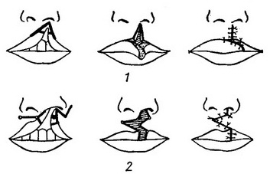
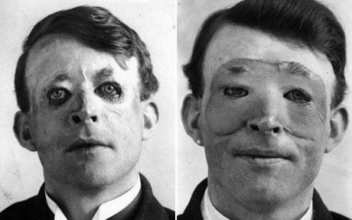
In 1845 Diffenbah (Germany) held a two-layer flap nose correction, in 1846 Cedilo developed a new solution in elimination of defect of the upper lip, which is used now.
In 1870 Piasecki offered freely transplanted pieces of skin, described the technique and brought transplantation of skin layers. In 1871 Yatsenko described in detail transplantation thin skin grafts, and in 1900 p. Zykov performed the first transplantation of bone to the jaw.

Slide 7
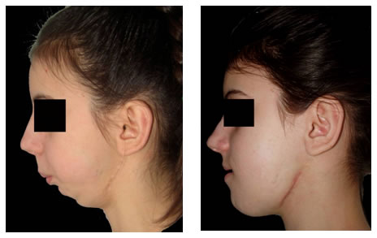
In the mid 1920-th, after Second World War in Europe a great amount of people aroused, which couldn't accept their defects and appealed to surgeons with the request for improving not only a function injured body parts, but and it appearance. Plastic surgery was pioneer in hundreds innovative development methods, including tissue and microvessels transplantation, technicians for maxillofacial surgery. One of the innovators and founders plastic and reconstructive surgery was famous Armenian-American surgeon Varazdat Hazandyan.

Slide 8
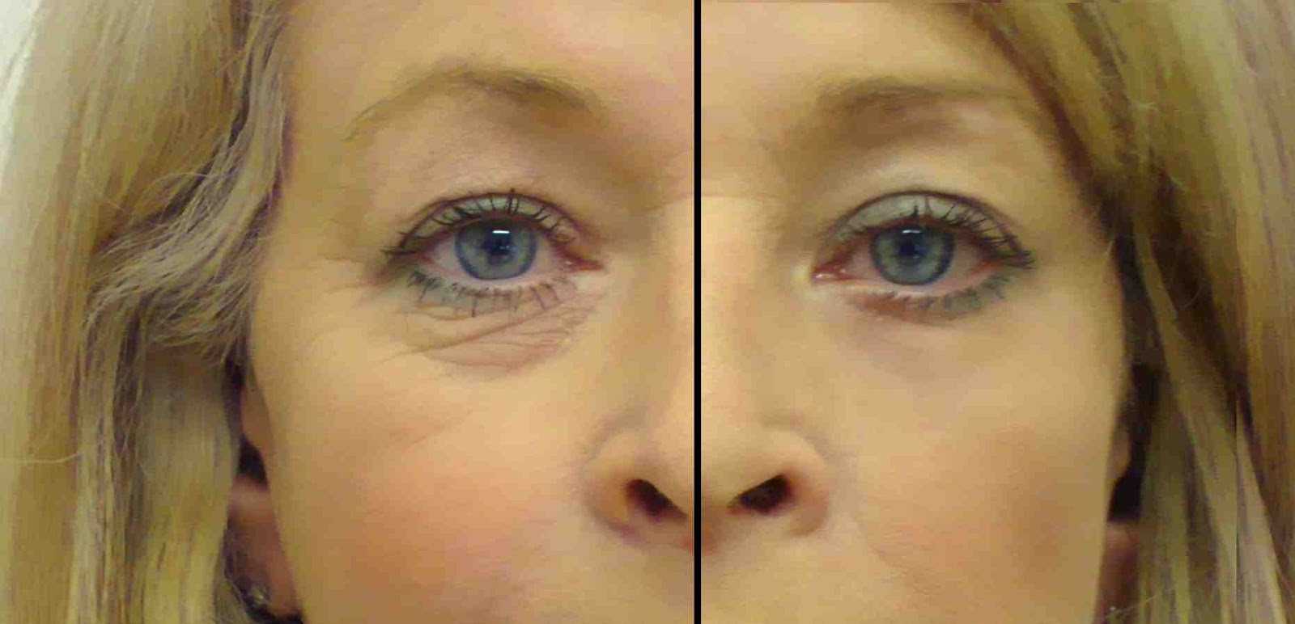
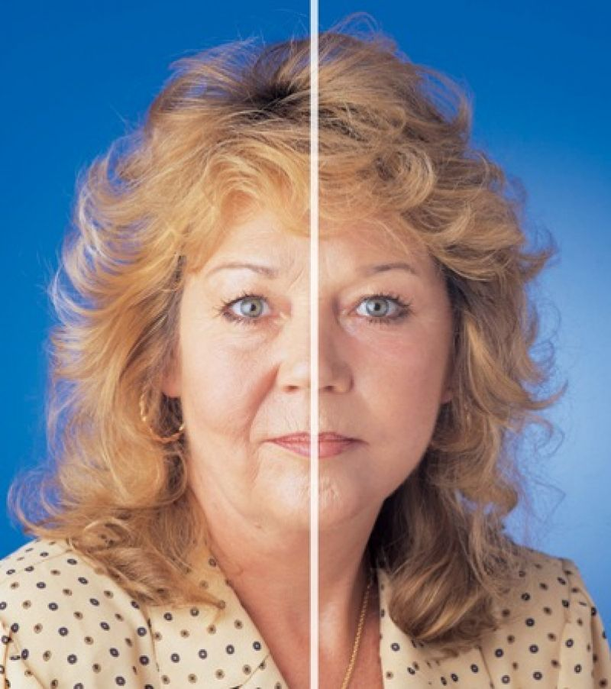
Plastic surgery gained it most popularity during the Second World War. At this time many soldiers received various injuries during the fighting, they needed plastic surgery.
Already in 60-80th years there have been opportunities to treat burns, frostbite and complex fractures, which was a major breakthrough for plastic surgery. This period was known as the "golden age" for this area of ​​surgery.
Science and technology has developed rapidly, which allowed not only to improve the quality of operations, but also pay attention to the aesthetic side procedure. At this time cosmetic surgery began to develop as s separate area that was used to improve the appearance and was called «aesthetic surgery».
At that time people of different social status could afford plastic surgery, which was the reason for the rapid spread of it.

Slide 9
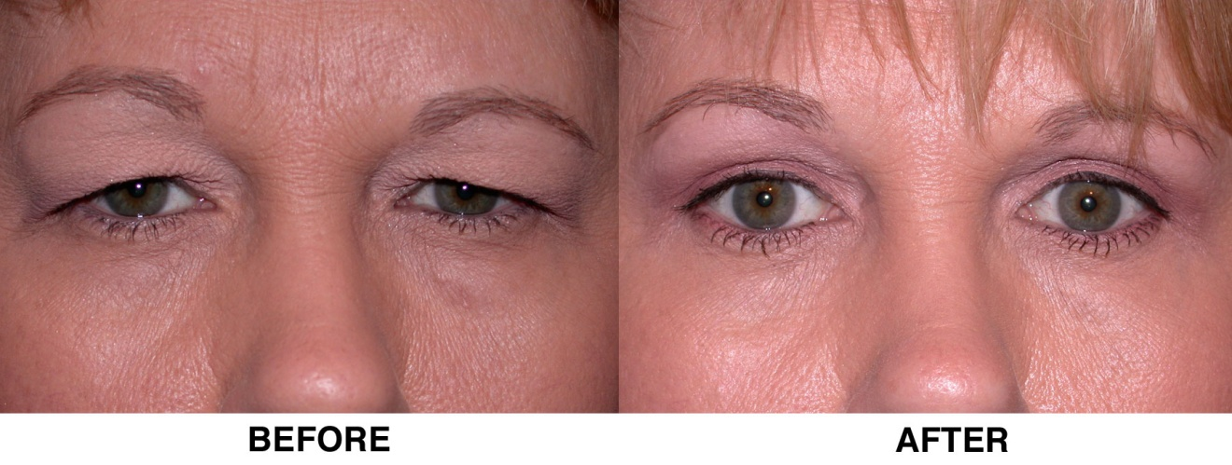
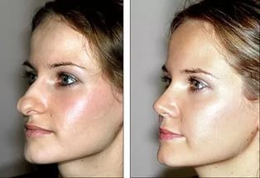

Some examples of modern plastic operations
Abdominoplasty - Correction of the abdomen, such an operation is performed under general anesthesia, remove stretch marks, fat or skin folds. Possible complications – hematomas, suture line disruption. The recovery period of 2 to 4 weeks. Effect - from weeks to years, depending on your physiology.
Blepharoplasty - correction of eyelids, eyebrows. Possible complications - almost no except a little redness, which disappears then. Effect - 5-10 years.
Rhinoplasty - nose shape correction, restoration of nasal breathing rehabilitation, it can take about a week, it’s possible to have black eyes and swollen nose, the effect will be with you for life.
Otoplastic - correction of ears, you can rid of bandage in a month, possible complications - infection cartilage, the effect will be with you for life.
Facelift - skin tightening of the face and neck. You can recover after such surgery in about a month, because facial nerves are damaged in such operations, the possible temporary numbness (reduced sensitivity of the skin). Usually, this operation prolongs youth for 7 - 15 years.
Maskliftinh- differs from conventional face lift, as performed through small punctures with a special video equipment, it allows for a shorter recovery period - 2-3 weeks.

Slide 10
THANK YOU FOR ATTENTION!

